Slide 1

Assalamualaikum Warahmatullahi Wabarakatuh

Slide 2
Dear Beloved Brothers and Sisters, please allow me to introduce to you the current AMC Executives:

Slide 3
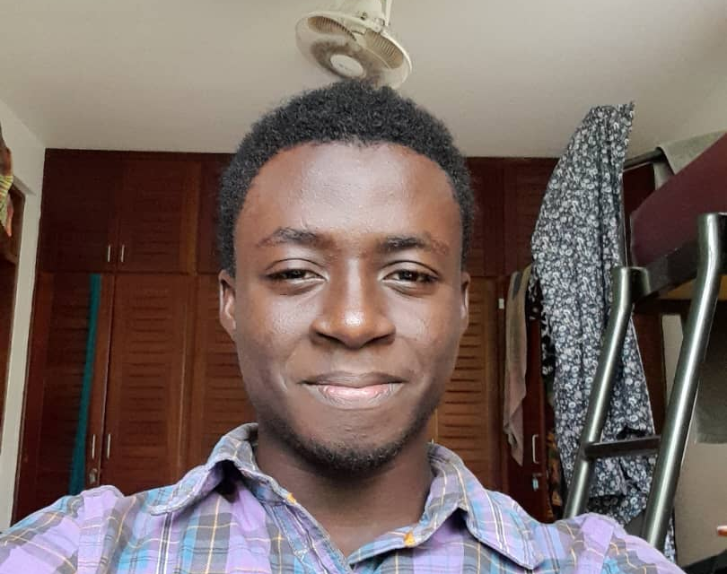
President
Faisal Alidu

Slide 4

Vice President
Abdoul Raouf Munkaila

Slide 5
Chief Imaam
Alhassan Furqaan

Slide 6
Dept. Chief Imaam
Afa Musah

Slide 7
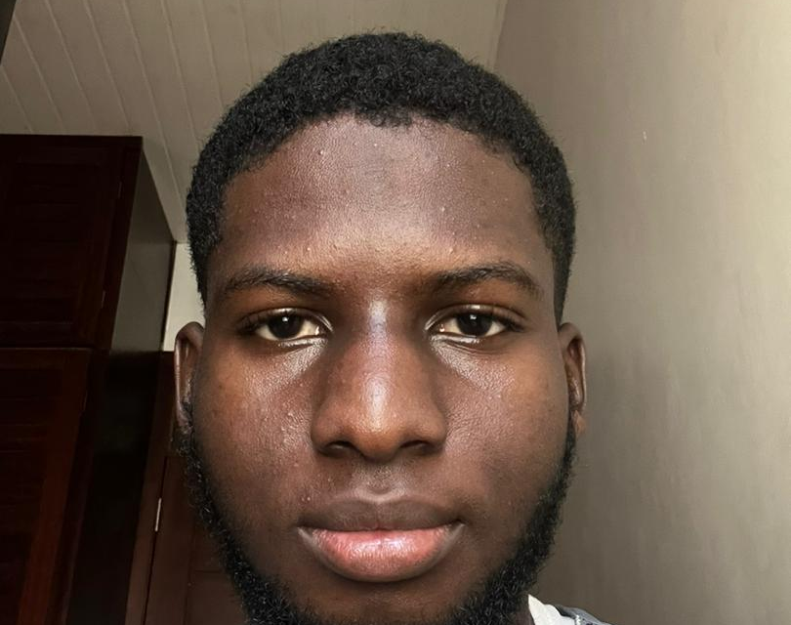
General Secretary
Mohammed

Slide 8
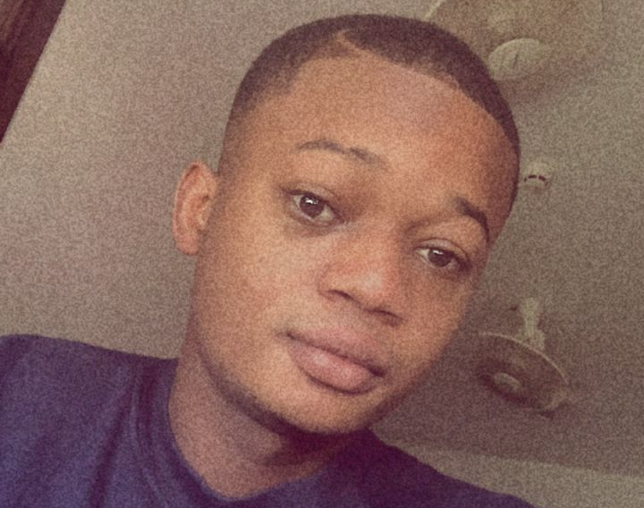
Finance Secretary
Morro Sulleyman

Slide 9

Women Commissioner
Mansura Mahabab

Slide 10
Women Organizer
Habiba Jingunaa

Slide 11
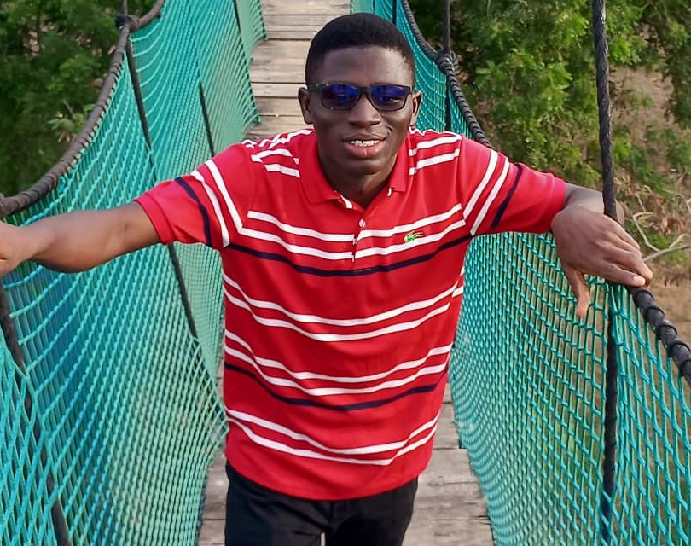
General Organizer
Alhassan Issah

Slide 12
Muazzin
Boubakar Soaley Moamadou

Slide 13
Muazzin
Ngoila Akim

Slide 14

Attention !!!
Note: Please pay special attention to Morro Sulleyman, our Finance Secretary/Treasurer, responsible for collecting dues for our upcoming Eid-ul Fitr plans

Slide 15
About the Dues
We aim to observe Eid prayers at Kanda, Accra, followed by a celebration
Payments will be collected by Morro Sulleyman from the 1st day to the 15th day of Ramadan
Our target is 80 contributors; failing to reach this goal will result in refunds and cancellation of our trip

Slide 16
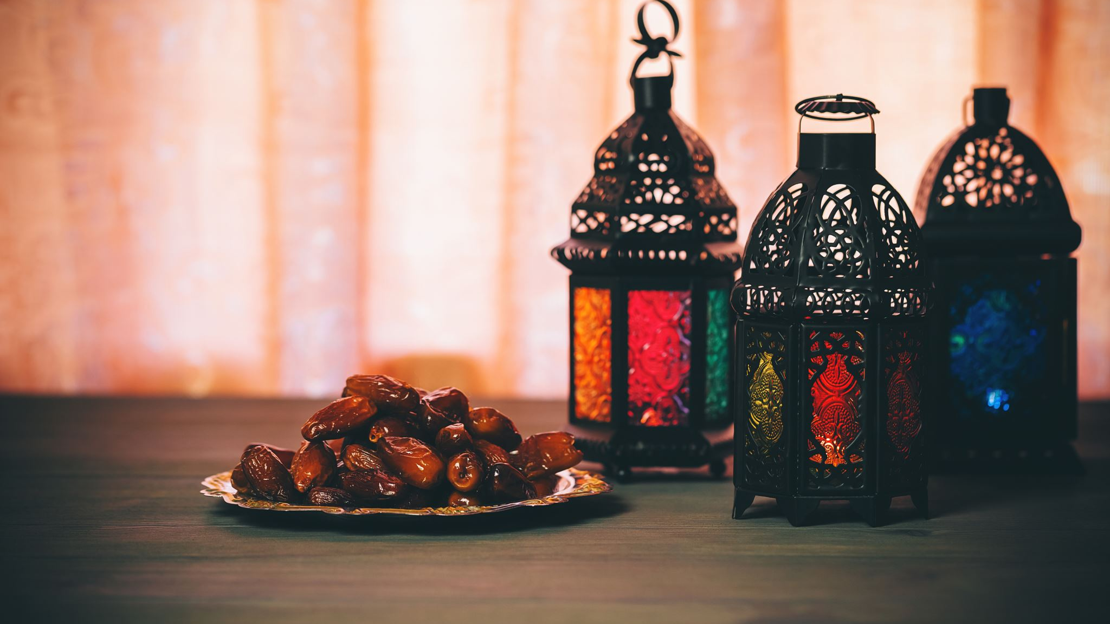
Call to Action
Let us all participate actively in this initiative to ensure a successful Eid celebration together

Slide 17
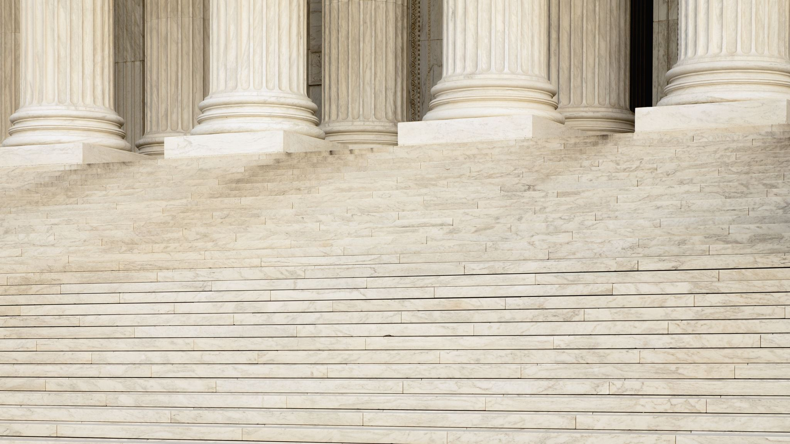
Request for Assistance
We kindly seek support for providing fruits for iftar during this Ramadan period. If you can assist, please reach out to any of the executives (both outgoing and current) or myself.

Slide 18

May Allah bless our collective efforts and strengthen our unity.
Walaikum Salam Warahmatullahi Wabarakatuh

